Slide 1
Federated Learning
A presentation by:-
Tushar Nayak

Slide 2
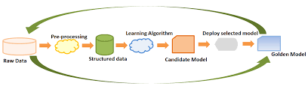
Some Background:
Machine Learning(ML):
It is a branch of Computer Science and subset of AI that deals with functions and algorithms that mimic human learning processes. The data collected by various sources is fed into the algorithms and the machine “learns” from the data to improve its accuracy in predicting outcomes from random datasets.

Slide 3
Client:
The user is known as the client. In the context of machine learning, it means the source of data for both training and testing.
Aggregator:
The software(s) that clean and sort the information collected from clients and turn it into presentable data that can be computed upon by the server.
Server:
The system or group of systems on which the ML model carries out training and testing. The server collects information from the clients, aggregates it and provides computational resources and clean data to the ML model to carry out its tasks.

Slide 4
What is Federated Learning?
History:
Until now, we have discussed classical ML. In 2016, to tackle some of the challenges of classic ML, a new approach to ML was proposed by McMahan and Team at Google called Federated Learning. It sought to mitigate some problems like privacy, need for high computational resources and need for low-latency,high speed network for ML.
What is it?
Instead of the centralized main server learning approach in classic ML, in federated learning, to quote McMahan(2016) : “We term our approach Federated Learning, since the learning task is solved by a loose federation of participating devices (which we refer to as clients) which are coordinated by a central server.”, which means that learning is decentralized and delegated to the client machines, and only training results are sent back to the central server, ensuring privacy and other benefits.

Slide 5
Why Federated Learning?
FL is currently in its infant stages, but current research has shown that it shows great promise in replacing classical approaches in ML for use in ML models in mobiles and in healthcare. Looking at short term benefits, we get lower latency and less power consumption while learning, because only updated model is sent, and no user data is sent back to the server, thus reducing training latency in on-server training. It also reduces power consumption by a combination of leveraging training across a large amount of devices and a tailored algorithm, called Federated Averaging algorithm(McMahan,2017).
But the biggest advantage comes in terms of increased privacy. FL’s approach to ML (along with measures such as Secure Aggregation and Differential Privacy) ensures that even in cases where there are millions and even billions of clients, individual privacy can be maintained without compromising functionality . There is also the advantage of being able to leverage distributed data, where classic ML would have to combine all user data before starting training, FL would be able to carry out the same tasks at smaller and more robust scales.

Slide 6
How does it work?
The background processes that take place during a complete cycle of training are mathematics heavy, but the overall process can be explained in simple terms, so I try to do that in the next few slides.
1.Check-in and selection:
At the start of a cycle, devices signal their availability to run an FL task (computations run on certain parameters specified in an FL population; either training on the data or testing trained models on separate data) to the main server. From this group of devices, the server selects a group of devices 1-2 magnitudes in order less than the no. of available devices to carry out said task. This initial communication between the server and devices is called a round. All other available devices are sent a rejection message, usually ”Cme back later!”.

Slide 7
2.Training:
After the training devices(henceforth called Td) are selected, the server sends an FL plan and FL checkpoint to the Tds. The devices FL plan to train themselves using the FL checkpoint and the Td user’s data. After training is done, the result is packed into a new FL checkpoint, henceforth called RFLC. The Td then unloads the FL plan and deletes the original FL checkpoint, and the process moves forward. Here, FL plan is the set of instructions given to the Td to carry out training. If seen in the context of TensorFlow, it is a data structure that includes a TensorFlow graph and instructions on how to propagate it. FL checkpoint is basically the current state of the global model(main application on the server) in terms of parameters with other necessary data packaged together.
Reporting and Aggregation:
Now, the RFLC is sent back to the main server after going through encryption, secure aggregation and differential privacy, and the original FL plan and checkpoint are deleted. During reporting, the server gives devices a timed window to report in. If enough devices report in, the cycle is considered successful. There are tolerances built in regarding devices checking in, and late or unresponsive devices are simply ignored. The timed window can be dynamically set with certain parameters in mind. For example, we can choose the no. of participating devices, a timeout and minimum participation goal count for success as parameters. This is called pace steering.

Slide 8
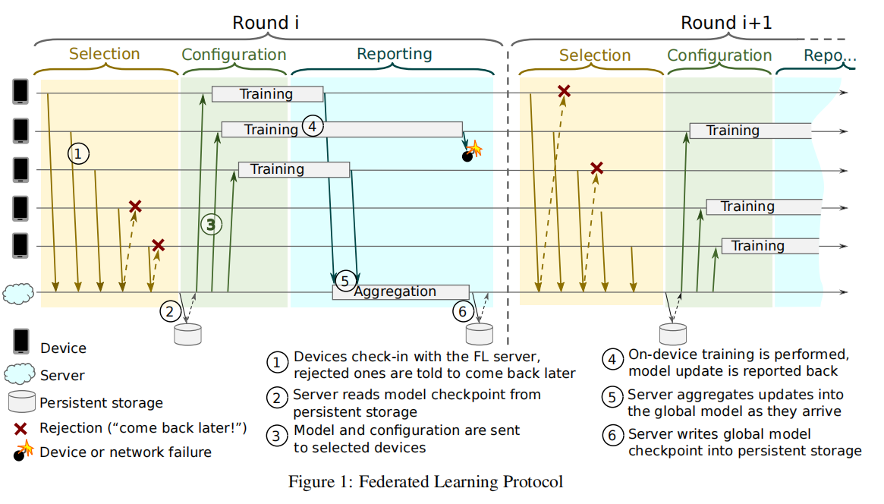
Then, the server decrypts and aggregates the RFLCs it has received and updates the global model accordingly. Then, the cycle starts anew. Here, I have given a figure from (arXiv:1902.01046v2 [cs.LG] 22 Mar 2019) for better understanding.

Slide 9
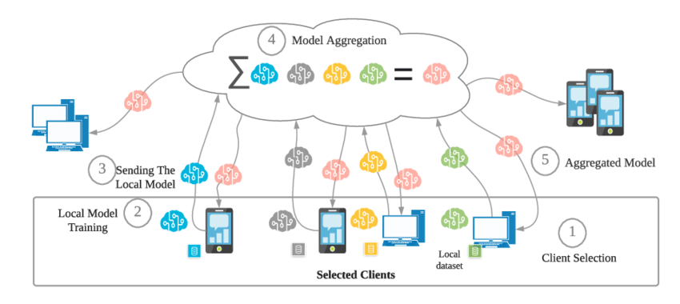
FL Process:

Slide 10
Where is it?
Now you might be wondering where FL has been used, if it has been used. Let me tell you that FL has already been implemented in the real world, and although limited due to novelty of the approach and due to it being a new field, it shows exciting prospects of what’s to come. Here are some examples:
GBoard:
All of us know about GBoard, google’s own keyboard. Now, google has implemented FL to help give typing suggestions. I quote McMahan,2017- “When Gboard shows a suggested query, your phone locally stores information about the current context and whether you clicked the suggestion. Federated Learning processes that history on-device to suggest improvements to the next iteration of Gboard’s query suggestion model.”

Slide 11
Healthcare:
The application of FL in healthcare, where doctor-patient confidentiality is seen as paramount while also having the need to apply ML to create cutting-edge diagnosis softwares and medicines, is as beneficial as it is necessary. It can not only assuage fears in patients about their personal files being leaked and help get rapid diagnoses in case of emergencies, it can also ensure that such concerns do not hackle the rate of progress of novel healthcare.
Its current applications can be seen in this paper-( Rieke, N., Hancox, J., Li, W. et al. The future of digital health with federated learning. npj Digit. Med. 3, 119 (2020). https://doi.org/10.1038/s41746-020-00323-1). In this paper, Rieke and Team have cited research into FL applications in the field of medical imaging, prediction of hospitalisation,mortality chance and ICU stay time in case of cardiac events and even in the context of COVID-19, to name a few.

Slide 12
Transportation:
The application of FL in transportation is particularly groundbreaking.
ML has been applied in not only smart vehicles, but also in drone systems and delivery truck routes for more efficiency and speed. Applying FL here can not only lead to faster and targeted training, it can also help mitigate latency for such training. Smart vehicles and delivery trucks cannot handle high speed, low latency, high energy computations required for such training tasks.
Especially smart vehicles, which now have a host of new applications onboard, and training on all that data with the onboard computer isn’t possible, so the data is offloaded to nearby edge servers for further training. Here, FL is a necessity, and it has been successfully tested as shown in this research paper- ( Shinde, Swapnil & Bozorgchenani, Arash & Tarchi, Daniele & Ni, Qiang. (2022). On the Design of Federated Learning in Latency and Energy Constrained Computation Offloading Operations in Vehicular Edge Computing Systems. IEEE Transactions on Vehicular Technology. 71. 2041 - 2057. 10.1109/TVT.2021.3135332).

Slide 13
What are the limitations,challenges and disadvantages of FL?
Now I’ve talked about what FL is,what its advantages are, how it has already been applied in the real world and its possible future applications. But FL is a field where research started very recently. In fact, the name was just coined in 2016. As such, there are many kinks to work out, and in its current form, it has many disadvantages and limitations.
Here are some of them, as shown by Peter and Team in Advances and Open Problems in Federated Learning(arXiv:1912.04977v3 [cs.LG] 9 Mar 2021)-
Fully decentralizing:
We define FL as a decentralized approach to ML, yet there is a single main server that coordinates the entire FL training cycle.

Slide 14
Although currently necessary, it also signifies the server’s status as a single point of failure. Once the main server fails, it will bring the entire system down with it. Therefore, a direction of further research would be to fully decentralize FL models.
Personalization and trust issues: Decentralizing also brings into question the robustness of current algorithms used in FL(Here,SGD)
in the face of malicious clients or unreliable data or labels. The improvement of security measures, failsafes and checkpoints is a further research direction.
Limited bandwidth and energy usage:Given the fact that we are leveraging client devices to carry out FL tasks, we are limited by the limited bandwidth, high latency connections and energy that can be alloted to such tasks. In such cases, transforming the current

Slide 15
computation heavy centralized algorithms to decentralized lightweight algorithms is an active research direction.
Privacy: Although FL boasts of more privacy measures compared to classical ML, improved privacy is always welcome.As such improving privacy is also a challenge currently being worked upon in FL. Current measures include client-level differential privacy(DF), where instead of adding Gaussian noise on the combined data, a certain amount of noise is added at the client level in the RFLC after which it is aggregated and should theoretically achieve the same result while ensuring client level data privacy.
These are only some limitations and challenges explored in the previously mentioned research paper, and we can see that FL is a new and constantly evolving field.

Slide 16
How is it implemented?
Now, i’ll be talking about the tools and platforms currently available implement FL. There are many open source softwares available for FL such as TensorFlow Federated,IBM Federated Learning,PySyft+PyGrid,Substra etc. to name a few. Now I will talk about each in some detail. The below data and information has been taken from a site that I will name in the end⁽¹⁾.
TensorFlow Federated:TensorFlow Federated (TFF) is a Python 3 open-source framework for federated learning developed by Google. The main motivation behind TFF was Google's need to implement mobile keyboard predictions and on-device search. TFF is actively used at Google to support customer needs.

Slide 17
IBM Federated Learning: IBM Federated Learning provides a basic framework for FL on which advanced features can be added. It is not dependent on any specific machine learning framework and supports different learning topologies, e.g., a shared aggregator, and protocols.
It is meant to provide a solid basis for federated learning that enables a large variety of federated learning models, topologies, learning models, in enterprise and hybrid-Cloud settings. IBM Federated Learning supports multiple machine learning models, such as those written in TensorFlow,PyTorch and Keras.
PySyft+PyGrid:PySyft is an open-source Python 3 based library that enables federated learning for research purposes and uses FL, differential privacy, and encrypted computations. It was developed by the OpenMined community and works mainly with deep learning frameworks such as PyTorch and TensorFlow.

Slide 18
PySyft defines objects, machine learning algorithms, and abstractions. With PySyft, you can't work on real data science problems that involve communication across networks. This would require another library, called PyGrid. PyGrid implements federated learning on web, mobile, edge devices, and different types of terminals. PyGrid is the API to manage and deploy PySyft at scale. It can be controlled using PyGrid Admin.
Substra:Substra is a federated learning software framework developed by a multi-partner research project around Owkin, a French startup founded in 2016. Substra is focused on the medical field with the purpose of data ownership and privacy. Today, it is used in the MELLODY project for drug discovery in the pharmaceutical industry.

Slide 19
An example of how FL works with TensorFlow Federated
Conclusion
import tensorflow as tf
import tensorflow_federated as tff
1.)# Load simulation data.
source, _ = tff.simulation.datasets.emnist.load_data()
def client_data(n):
return source.create_tf_dataset_for_client(source.client_ids[n]).map(
lambda e: (tf.reshape(e['pixels'], [-1]), e['label'])
).repeat(10).batch(20)
2.)# Pick a subset of client devices to participate in training.
train_data = [client_data(n) for n in range(3)]
3.)# Wrap a Keras model for use with TFF.
def model_fn():
model = tf.keras.models.Sequential([
tf.keras.layers.Dense(10, tf.nn.softmax, input_shape=(784,),
kernel_initializer='zeros')
])
return tff.learning.models.from_keras_model(
model,
input_spec=train_data[0].element_spec,
loss=tf.keras.losses.SparseCategoricalCrossentropy(),
metrics=[tf.keras.metrics.SparseCategoricalAccuracy()])
4.)# Simulate a few rounds of training with the selected client devices.
trainer = tff.learning.algorithms.build_weighted_fed_avg(
model_fn,
client_optimizer_fn=lambda: tf.keras.optimizers.SGD(0.1))
state = trainer.initialize()
for _ in range(5):
result = trainer.next(state, train_data)
state = result.state
metrics = result.metrics
print(metrics['client_work']['train']['loss'])
In conclusion, I would like to say that, despite its current shortcomings, FL is a very promising successor to classic ML. Once its kinks have been worked out, we will have fully decentralized learning models that do not depend upon a single server, can update themselves continuously based on local rather than global parameters, and provide very effective data privacy while still giving the same if not more accurate training results compared to classic ML.

Slide 20
Sources:
I have given my sources in the relevant slides,but here are some that I couldn’t write in the slides:
1)https://www.apheris.com/resources/blog/top-7-open-source-frameworks-for-federated-learning

